Slide 1

Audio Dog Bark Identification A Machine Learning Approach
Introduction to Machine Learning featuring Prof. Musco
A Hot Dawg Presentation by: Pawel Juda and Bryan Khuu

Slide 2
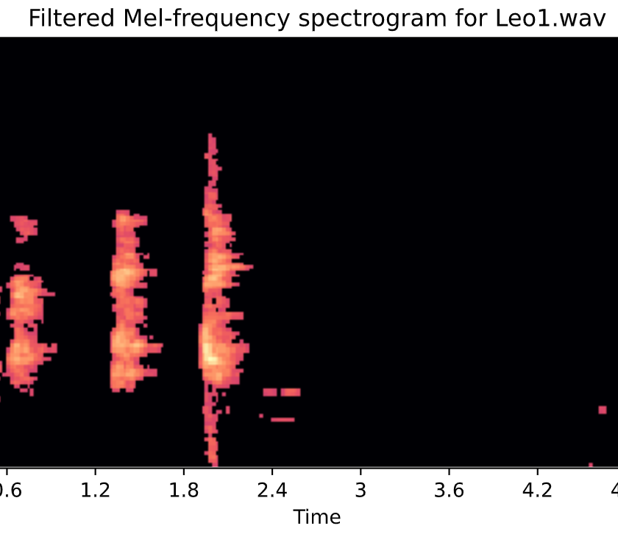
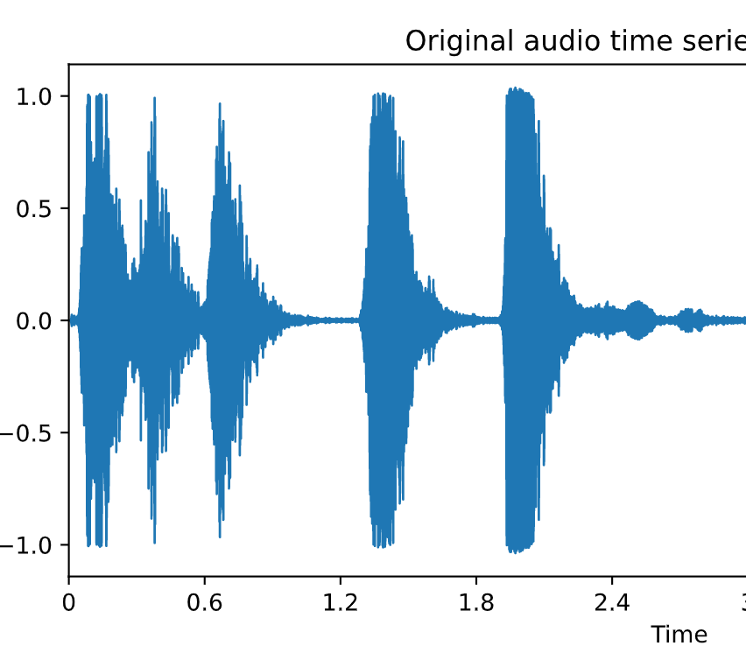
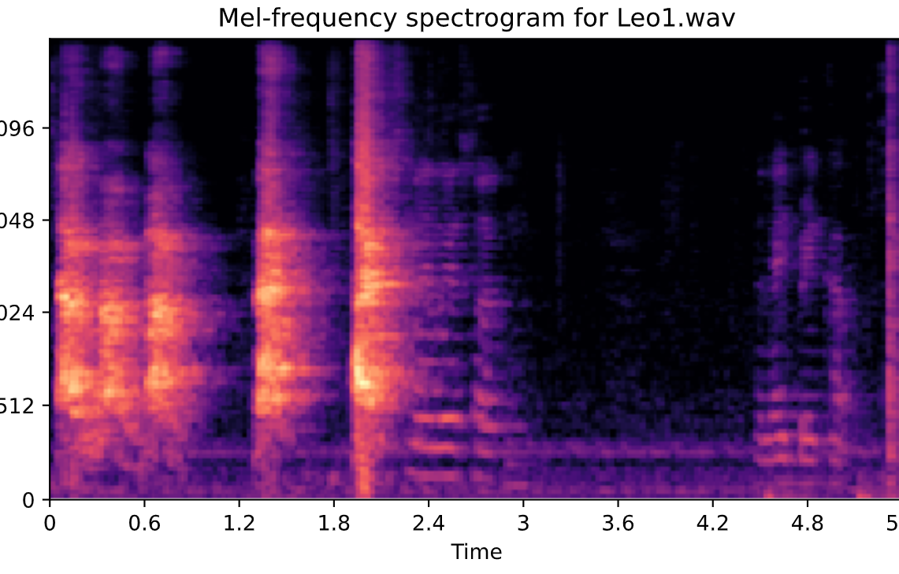
Dataset Organization and Feature Extraction
Online Source : Kaggle https://www.kaggle.com/mmoreaux/audio-cats-and-dogs
Live Source : Household Dog
Bichon Frise

Slide 3
Dogs were harmed in this presentation

